Slide 1

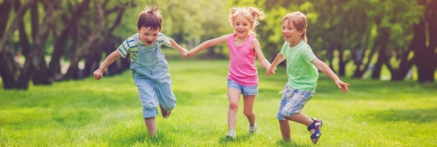
Relationships Education
Parent information

Slide 2

What is Relationships Education?

Slide 3

What is Relationships Education?
Forms part of the PSHE (personal, social, health and economic) curriculum.
Lessons on puberty and body changes (taught in year 6 only) are usually taught in Summer Term.
Human reproduction (year 5) usually taught in Summer term
However relationships education also takes place throughout the year. Lessons about keeping safe, good and bad touch, people who help us, good friendships and peer pressure are taught consistently in all year groups.

Slide 4
DfE statutory guidance for primary schools

Slide 5
Relationships Education
Families and people who care for me
Caring friendships
Respectful relationships
Online relationships
Being safe

Slide 6
Health Education
Mental wellbeing
Internet safety and harms
Physical health and fitness
Healthy eating
Drugs, alcohol and tobacco
Health and prevention
Basic first aid
Changing adolescent body

Slide 7
Why is Relationships Education important?
Develop confidence in talking, listening and thinking about feelings and relationships.
Are able to name parts of the body and describe how the body works.
Have the skills, language and confidence to protect themselves.
Are prepared for puberty.

Slide 8
Relationships Education and safeguarding
These are key concepts:
Universal language spoken by all
Online safety
Appropriate and inappropriate touch
Promotes healthy relationships

Slide 9
Four main topics
Growing up
Our bodies
Keeping safe
Relation-ships and family life

Slide 10
Relationships Education themes
Respect Emotions Friendships
Saying No Good and bad touch
Differences Families and people who care for me
Puberty Empathy Keeping safe
Communicating Building self-esteem
Sex Solving problems

