Slide 1

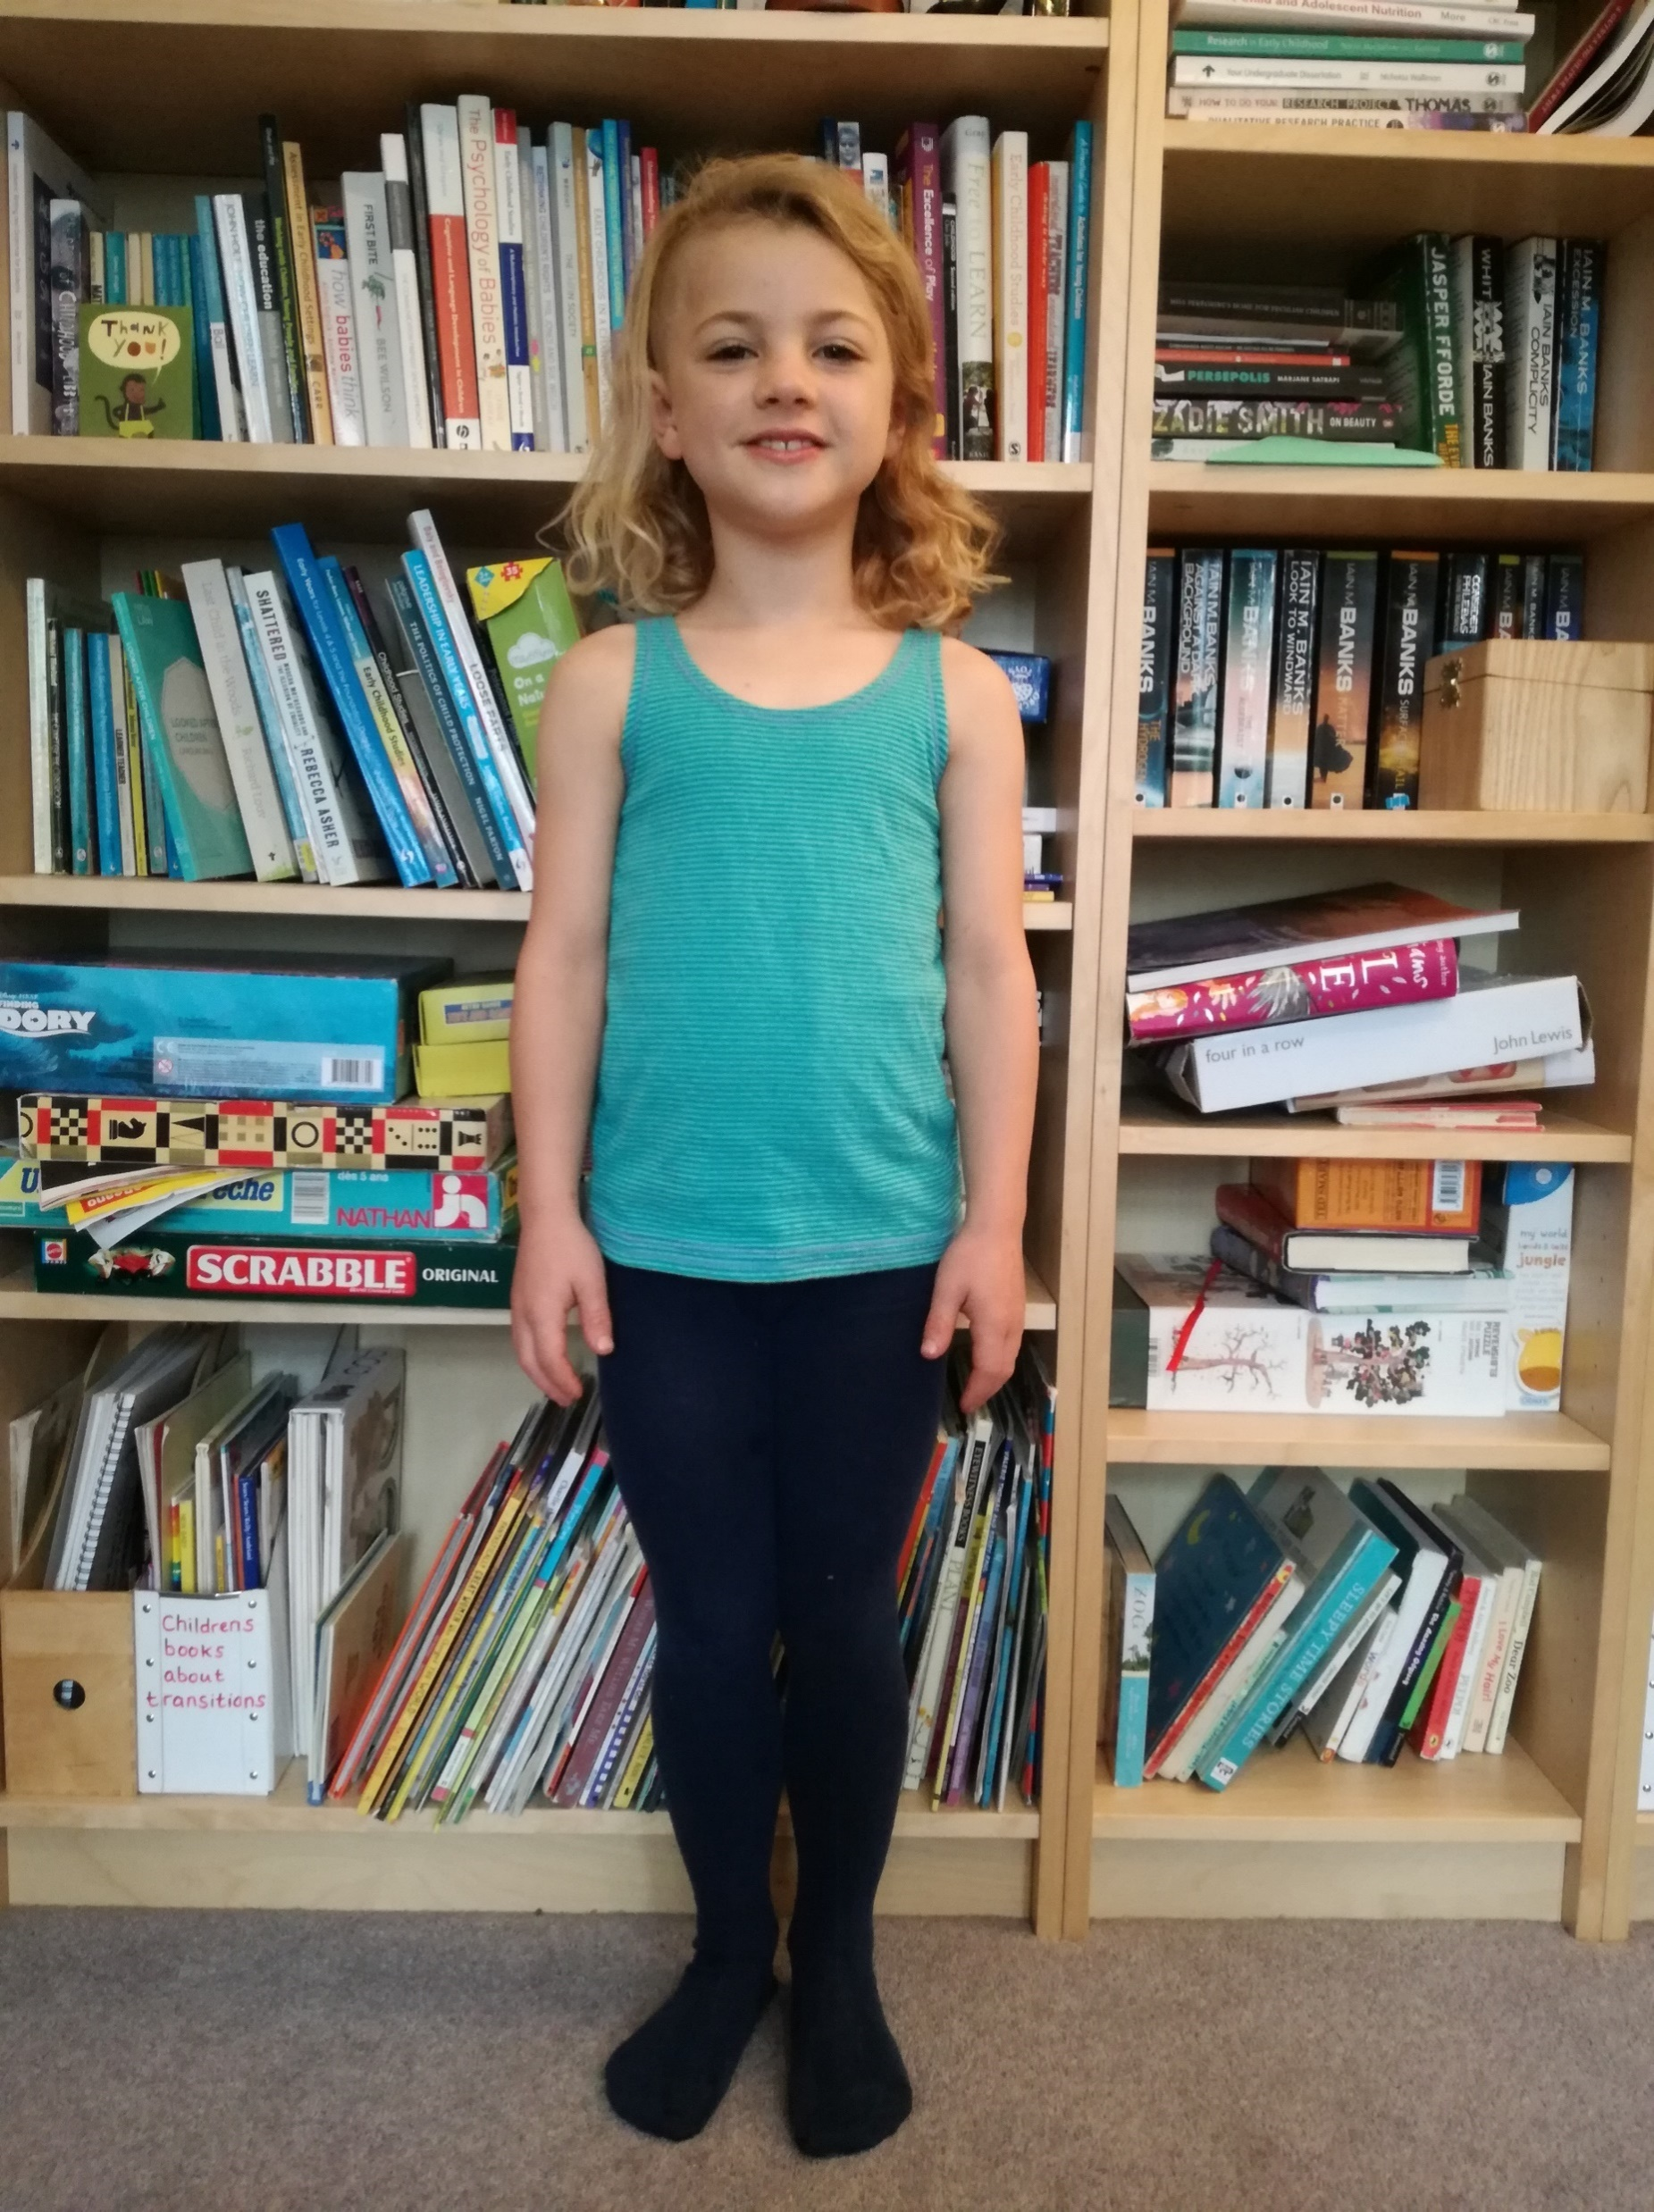
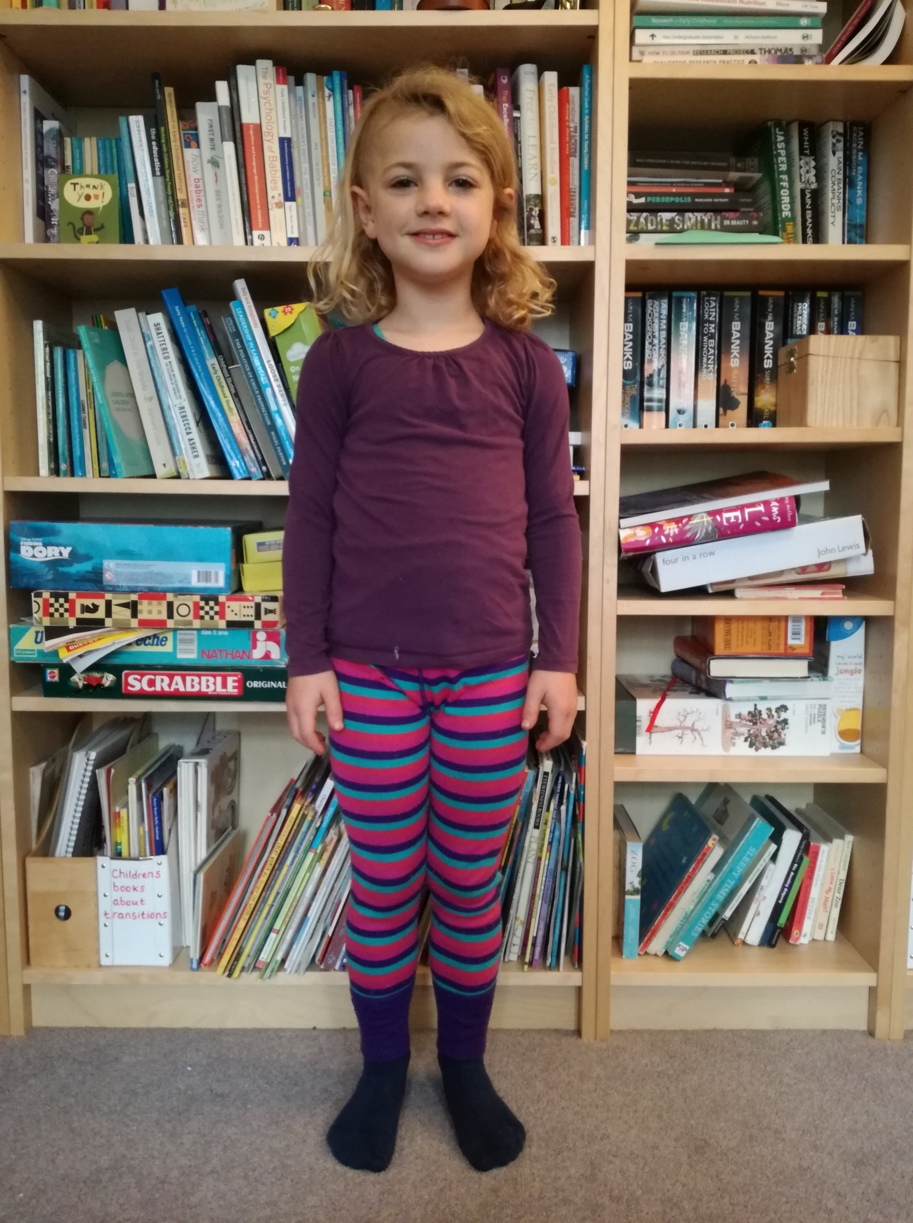
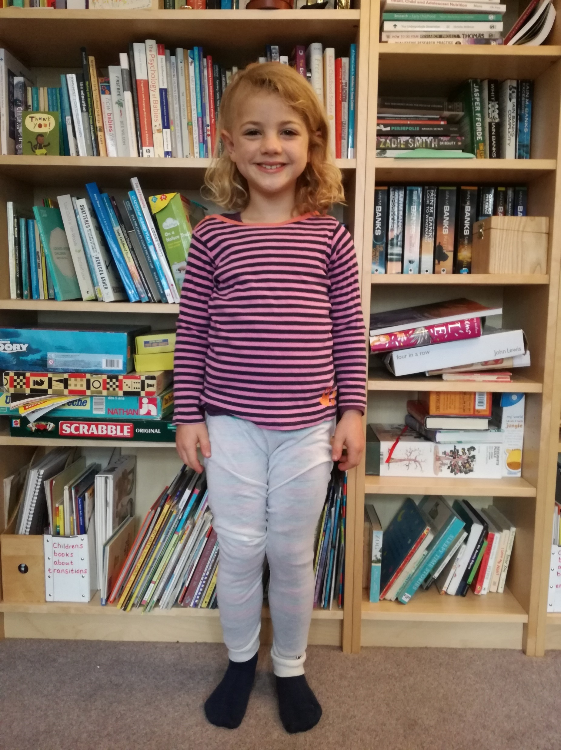
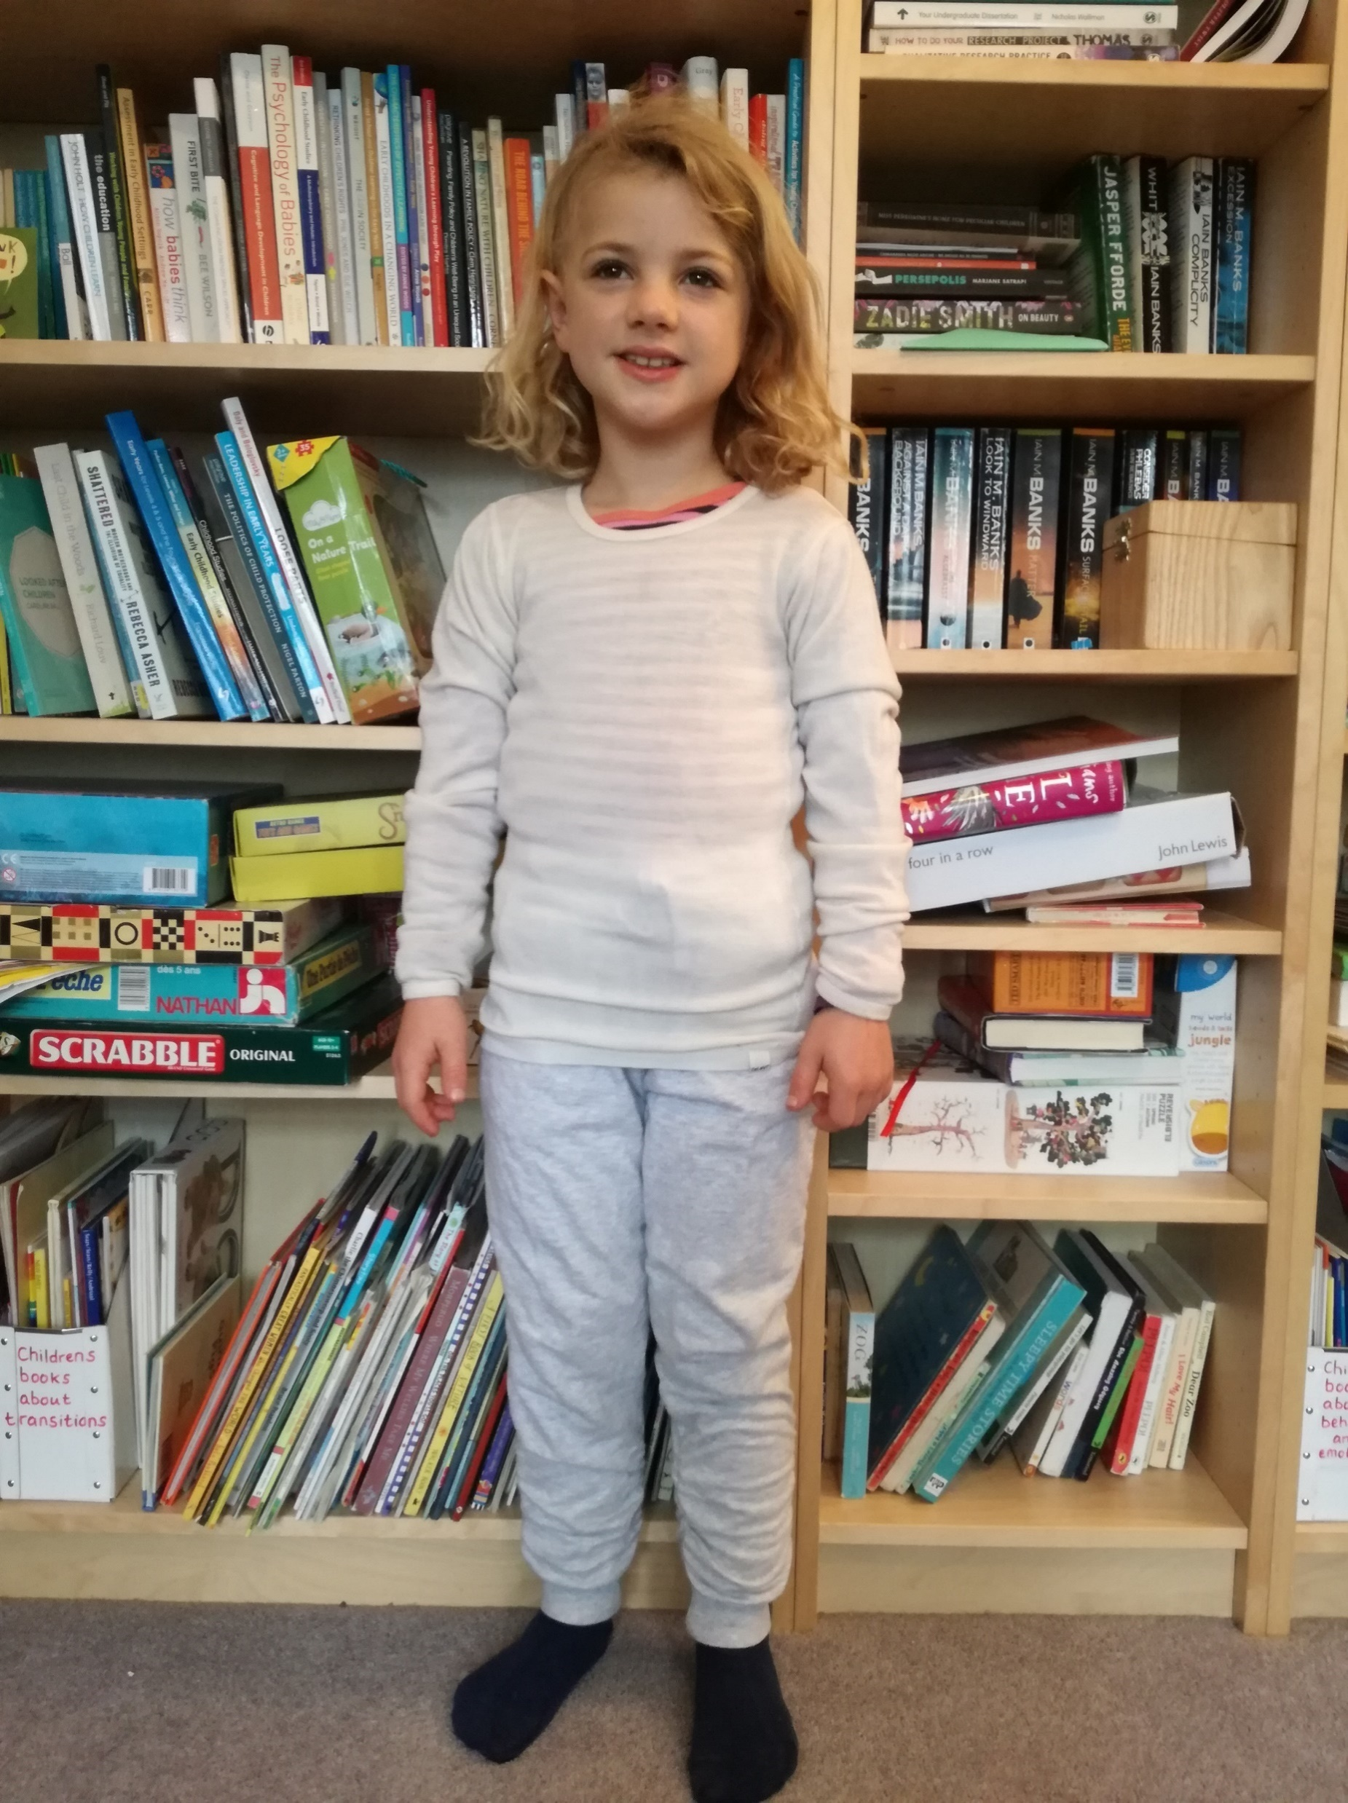
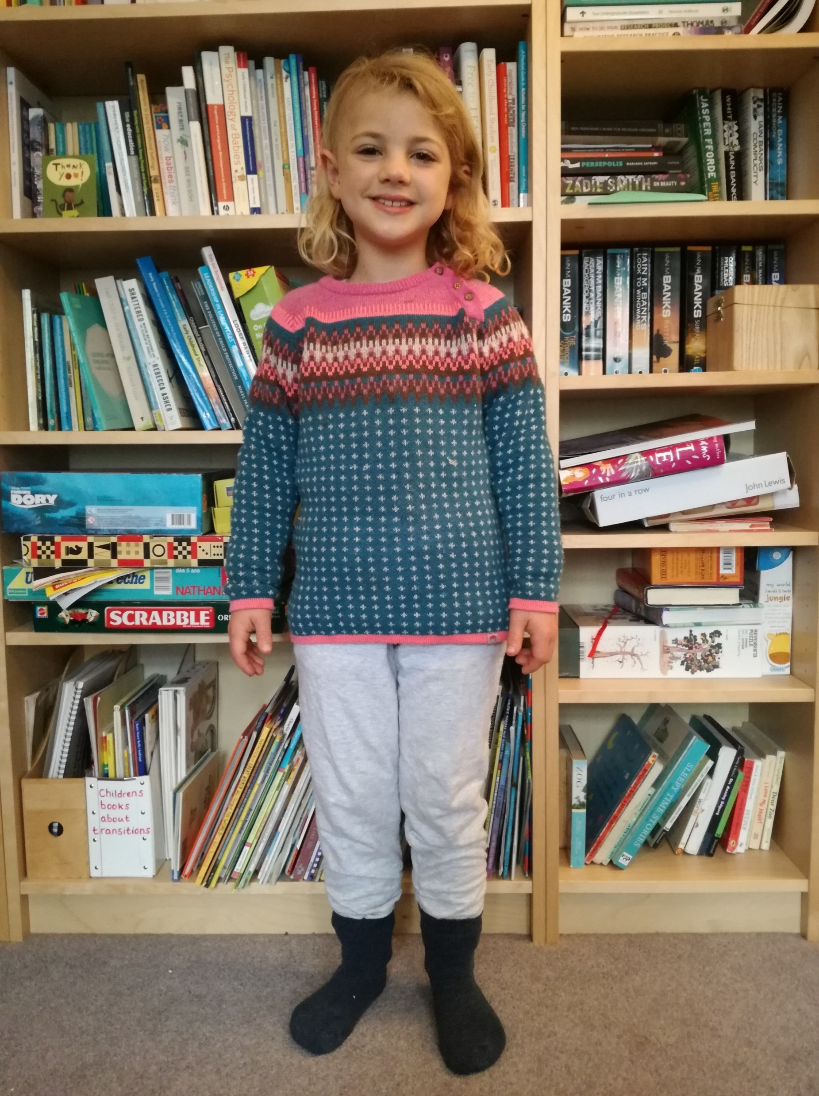
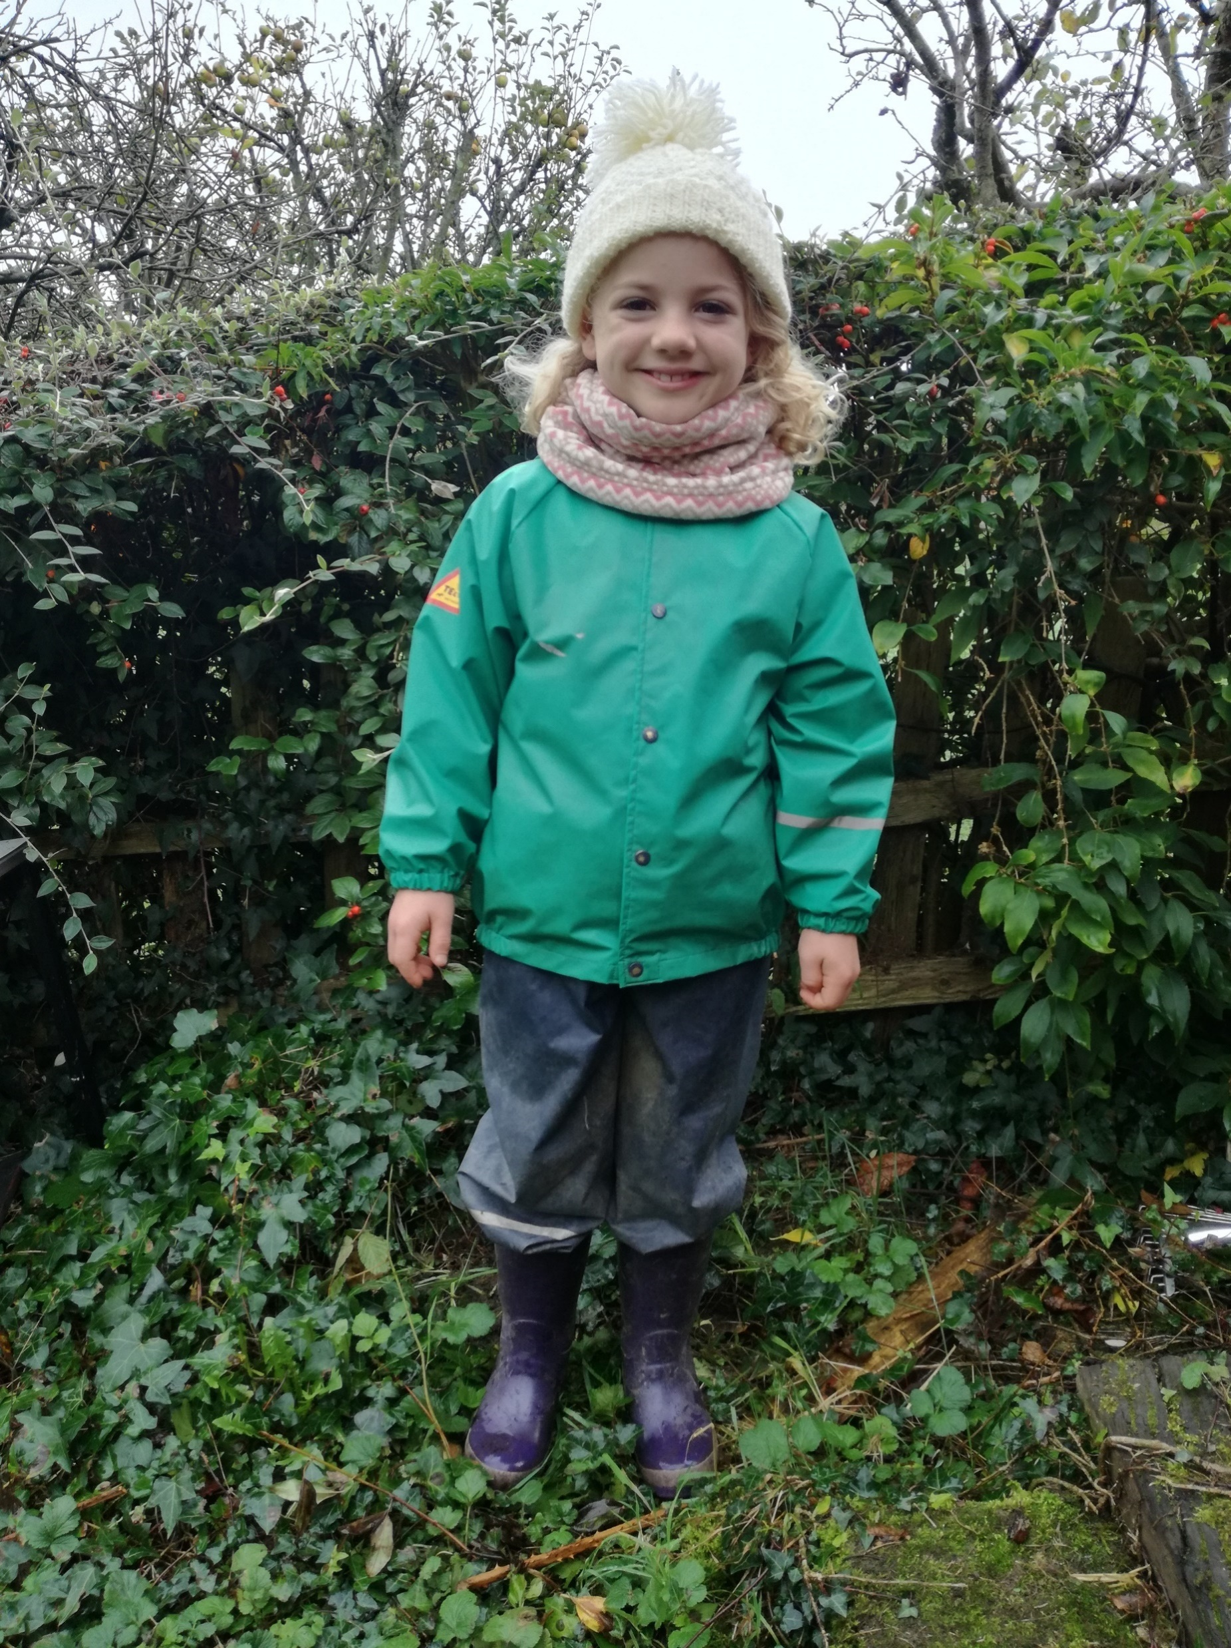
Dressing for Forest School and outdoor play:
keeping warm through the cold months.
Tip: normal welly boots and fleece lined welly boots don’t tend to be warm enough… Go for neoprene lined welly boots or some decent walking boots and wear a few pairs of socks too.
Tip: wearing lots of thin layers is better than wearing fewer thick layers.
Tip: natural materials like wool are the best for warmth and comfort.
Tip: once children get cold they find it hard to warm up, so get dressed before heading out.
1. Flo starts by wearing a thick vest and a pair of wool blend tights.
2. She adds one thin, long-sleeved top to her upper body and some merino wool thermal trousers to her legs.
3. She adds another thin, long-sleeved top to her upper body and another pair of merino wool trousers to her legs.
Tip: little hands need comfy mittens or gloves that don’t inhibit their fingers from working.
Tip: check that your child is comfortable and can move with ease - materials should be flexible.
4. Then She adds a merino wool thermal top to her upper body and a pair of thick jogging bottoms to her legs.
5. Flo puts on a jumper (80% wool) and a couple of pairs of socks on her feet.
6. Finally Flo adds waterproof trousers, a waterproof coat, neoprene lined waterproof boots and a wool hat. She is ready to play!
Flo is wearing five layers on her legs, four layers on her feet and six layers on her upper body but she can still move with ease.

